Slide 1

Banking reforms and it’s impact.

Slide 2

Group members
SUJEET SHETTY-70
VAIBHAVI KHANOLKAR-73
VISHAKHA GODHA-75
ZEBA TAHIR-77
MANSI BAKHAI-79
ZIL SHAH-81

Slide 3
FLOW
Banking sector in India
Growth phases in banking sector
Banking reforms in India
Decline in productivity and profitability
Reforming phase
First and second phase reforms and implementations and impacts
Recent and future banking reforms and technology advances.
KYC norms
Expected outcomes
Problems faced by PSB’s
Summary

Slide 4
Banking Sector In India
Reserve Bank India
Scheduled banks
Commercial banks
Co-operative banks
Foreign banks(40)
Regional rural banks(196)
Urban co-operatives
(52)
State co-operative(16)
Public sector banks(27)
Private sectors banks(30)
Old(22)
New(8)
State bank of India(8)
Other nationalized banks(19)

Slide 5
Growth phases in banking sector
In over five decades since dependence, banking system in India has passed through five distinct phase,
Evolutionary Phase (prior to 1950)
Foundation phase (1950-1968)
Expansion phase (1968-1984)
Consolidation phase (1984-1990)
Reformatory phase (since 1990)

Slide 6
Banking reforms in India
The Indian banking sector is an important constituent of the Indian financial system.
The banking sector plays a vital role of promoting business in urban as well as in rural areas in recent years.
Without it India can not be considered as a healthy economy.
For the past three decades India's banking system has several outstanding achievements to its credit

Slide 7
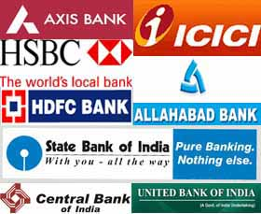
Decline In Productivity And Profitability
The Narasimham Committee-I identified the
following factors as responsible for decline
in income earnings:
Directed credit program of deploying 40% of
bank credit to the priority sectors at low interest rates.
Low capital base.
Low technology.
Phenomenal branch expansion.
Political interference in loan disbursal
and poverty eradication programs

Slide 8
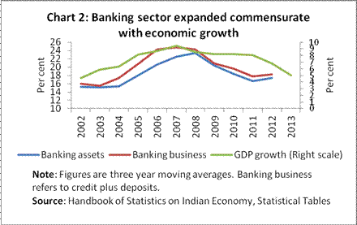

Slide 9
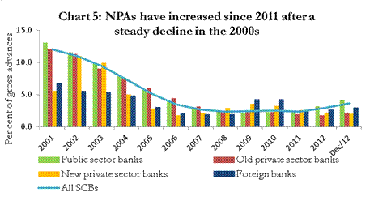

Slide 10
Reformatory Phase (1991 Onwards)
Reasons for the formation of the reforms-
Continued financial profligacy of the Government coupled with close monitoring and control
Decline in productivity and profitability
Economic crises of 1991
Economy suffered from serious inflationary pressures, emerging scarcities of essential commodities and breakdown of fiscal discipline.

Slide 11
FIRST PHASE OF REFORMS OF BANKING SECTOR (1991)
The Narsimham Committee I appointed to restore the financial health of commercial banks and to make their functioning efficient and profitable
Recommendations aimed at changes according greater flexibility to bank operations
The Committee submitted its report in November 1991 with 23 recommendations

Slide 12

Implemented Recommendations
Lowering SLR and CRR
Prudential Norms
Capital Adequacy Norms
Deregulation of Interest Rates
Recovery of Debts
Competition from New Private Sector Banks
Phasing Out Of Directed Credit
Access to Capital Market
Local area banks
Supervision from commercial banks

Slide 13

Impact on Indian Banking Sector
Intense competition
Lowered pre-emptions
Broadening the ownership
base of PSBs
Value Added Services

Slide 14

SECOND PHASE OF REFORMS OF BANKING SECTOR (1998)
The Committee placed greater importance on structural measures and improvement in
standards of disclosure and
levels of transparency.
Recommendations of
Narasimhan Committee II

Slide 15

Implemented Recommendations
New areas
New instruments
Risk management
Customer service
Universal banking
Information technology
Increase in FDI limit

Slide 16

Mergers And Amalgamation
Guidelines For Anti-Money Laundering
Managerial Autonomy
Increase of inflow credit
Strengthen technology
Base Rate System Of Interest Rates
Adoption of global standards
Management of NPAs

Slide 17
Recent banking reforms
Granting of operational autonomy to public sector banks.
Introduction and phased implementation of international best practices and norms.
Setting up of Credit Information Bureau of India Limited (CIBIL) for information sharing on defaulters as also other borrowers.
Introduction of automated screen-based trading in government securities through Negotiated Dealing System (NDS). Setting up of risk-free payments and system in government securities through Clearing Corporation of India Limited (CCIL). Phased introduction of Real Time Gross Settlement (RTGS) System.

Slide 18
Challenges for 2014-15
Deceleration in economic growth impacting expansion of banking sector
Maintaining asset quality in the face of growing non-performing assets and restructuring of advances
Augmenting capital and maintaining prudential capital
Implementing financial inclusion & Direct Benefits Transfer
Increased competition within the banking sector
Adopting and adapting to technological changes to meet regulatory norms and tap alternative channels
Improving quality of human resources for working efficiently under the latest technological developments

Slide 19
Reforms on the way
Strict norms pertaining to bad loans and restructured assets
Consolidation and mergers and entry of new players
Continuous bank licensing
Converting some urban cooperative banks into commercial banks
Focus on asset–liability management for banks
Increased usage of technology in banking
Focus on financial inclusion
Transparency, improvement in clearing and settlement practices

Slide 20
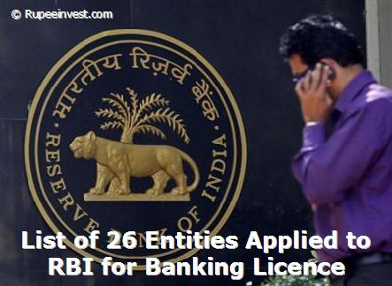
BANKING LICENSES
The RBI has mandated new banks to open 25% of their branches in unbanked regions right from the beginning of its inception
25 applicants, approval to two applicants
IDFC Limited and Bandhan Financial Services Private Limited
Banking structure in India
Small banks in private sector
Licensing of payment banks
Different bank targeting
different people

Slide 21
KYC NORMS
Banks were advised to follow certain customer identification procedure for opening of accounts and monitoring transactions of a suspicious nature for the purpose of reporting it to appropriate authority.
Recommendations made by the Financial Action Task Force (FATF) on Anti Money Laundering (AML) standards and on Combating Financing of Terrorism (CFT).
Banks should frame their KYC policies incorporating the following four key elements: (i) Customer Acceptance Policy; (ii) Customer Identification Procedures; (iii) Monitoring of Transactions; and (iv) Risk management.
Money laundering rules and regulation.

Slide 22
PROBLEMS FACED BY PSBs
Rising non-performing assets (NPAs)
Poor credit appraisal, over leveraging and the practice of giving fresh loans to pay off the old ones and leaving the mess for the successor are some of the practices that are prevalent in the Public banking system.
Over the last decade, the share of Public sector banks in banking loans has risen only marginally. However, their share in gross NPAs has gone up at an alarming rate.
Banks and policymakers give a serious thought to bringing some positive changes in the way Public sector banks operate.

Slide 23

Technology In Banking
Revolutionized banking practices
WAN , INFINET , IPSS
EFT
Debit and credit cards
Phone banking
ATM
Internet banking

Slide 24
Expected outcomes
Norms on NPA to improve asset quality, recovery, liquidity and the balance sheets of banks
Consolidation of banks & new players to bring competition, innovation and productivity. It would also bring economies of scale
Conversion of Urban banks into commercial banks could aid them to operate in mainstream with lower risk.
Higher technology usage to help in up gradation, design more e-products; also sustain and scale business
Financial deepening to make banking more inclusive, improve geographical coverage, reduce regional imbalances and credit to the unorganised sector

Slide 25

Summarizing The Reforms
Long term relationship
Pervasive in covering all
problem areas
Passed through a series of
discussion
Mentioned in the annual
report of RBI

Slide 26

Future Of Banking
Multilayer banking structure
Dilution of government stake PSBs
Slow growth rate of the
economy
Difficulty in entry at the
market level

Slide 27


